Slide 1
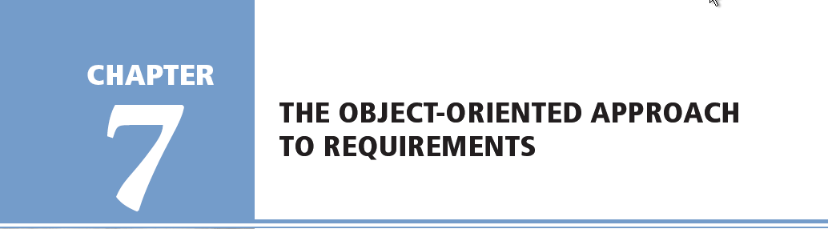

Systems Analysis and Design in a Changing World, Fifth Edition

Slide 2
The Unified Modeling Language and the Object Management Group
Object-oriented modeling notation is Unified Modeling Language (UML)
UML was presented to Object Management Group (OMG) as standard modeling technique
Purpose of Object Management Group
  Promote theory and practice of object technology for development of distributed systems
  Provide common architectural framework for OO

Slide 3
Object-Oriented Requirements
Object-oriented system requirements are specified and documented through process of building models
Systems development process starts with identification of events and things
Events are business processes that new system must address
Things are problem domain objects involved in business process

Slide 4
Object-Oriented Approach Models
Class diagram – definition of system components
Use case diagrams and use case descriptions – What are user roles and how they use the system
Systems sequence diagrams (SSDs) – define inputs and outputs and sequence of interactions between user and system for a use case
Statechart diagrams – describe states of each object
Activity diagrams – describe user activities

Slide 5
Overview
The objective of requirements definition is understanding – understanding the users’ needs, the business processes, and the systems to support business processes
Understand and define requirements for a new system using object-oriented analysis models and techniques
Line between object-oriented analysis and object-oriented design is somewhat fuzzy
  Iterative approach to development
  Models built in analysis are refined during design
Systems Analysis and Design in a Changing World, 5th Edition

Slide 6
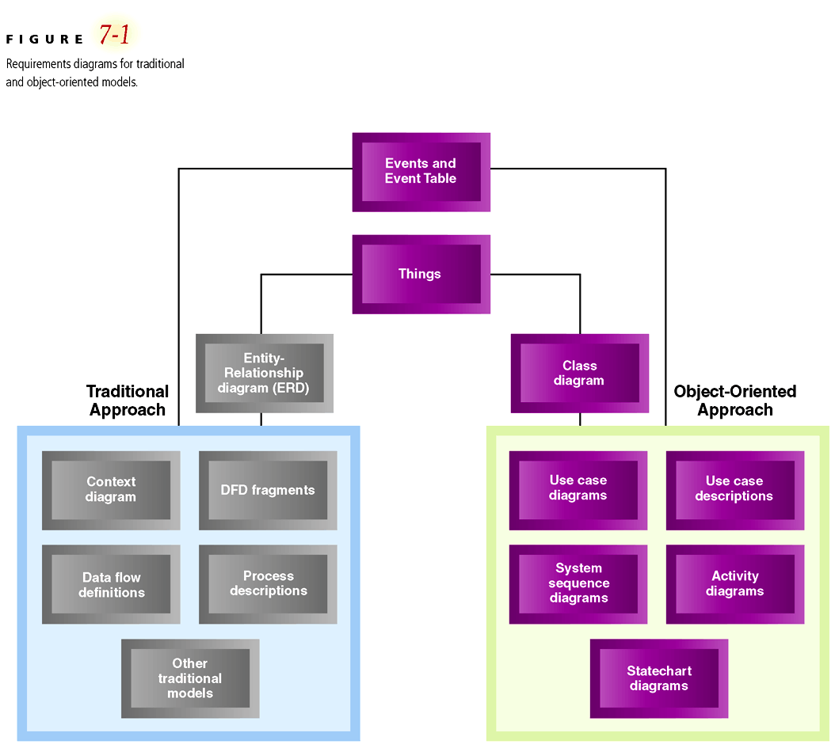
Requirements Diagrams: Traditional and OO Models

Slide 7
The Class Diagram
There are two kinds of descriptions of systems
  Structural information (components of the system)
  Behavioral information (logic performed by components)
Class diagram provides definition of structural components of the system
The other OO diagrams (e.g. use case, sequence, collaboration) focus on activities the system performs
NOTE – with OO Analysis, the class diagrams describes system requirements that can map very closely to the structure (i.e. classes) in the OO computer program that will be eventually created

Slide 8
Generalization/Specialization Hierarchies
Hierarchies that structure or rank classes from the more general superclass to the more specialized subclasses (sometimes called inheritance hierarchies)
Generalizations
  group similar types of things like all cars share certain features (e.g. all cars have wheels, engine etc.)
Specializations
  are judgments that categorize different types of things (e.g. sports car is a special type of car)
A generalization/specialization hierarchy structures things from the general down to the more special
  Each class has a more general class above it – a superclass
  A class may have a more specialized class below – a subclass

Slide 9
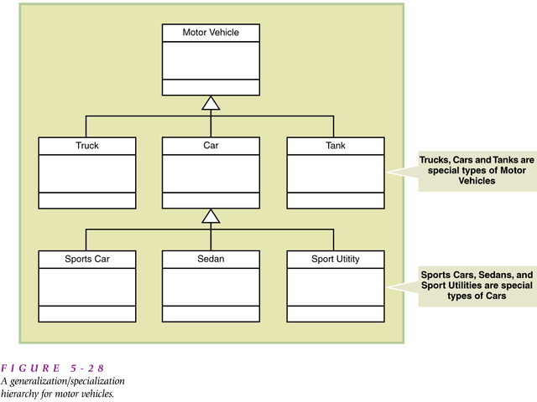

Slide 10
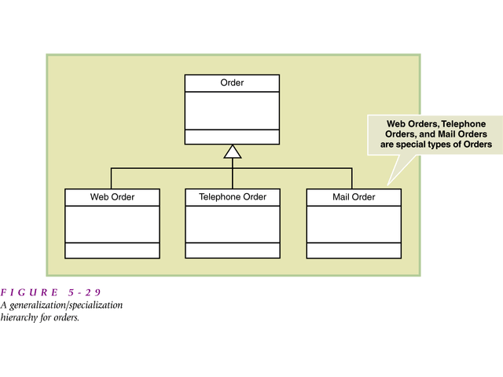

Slide 11
Inheritance
Inheritance: a concept that allows subclasses to share characteristics of their superclasses
E.g. a sports car has everything a car has (e.g. 4 wheels and an engine, which it “inherits” from the class car which is above it)
The sports car then specializes
  E.g. has a sports option, racing wheels etc.

Slide 12
Aggregation (Whole-Part Hierarchies)
Can also structure things by defining them in terms of parts
Aggregation: A relationship between and object and its parts
E.g. aggregation in the context of a computer system, a computer system is made up of:
- processor, main memory, keyboard, disk storage, monitor

Slide 13
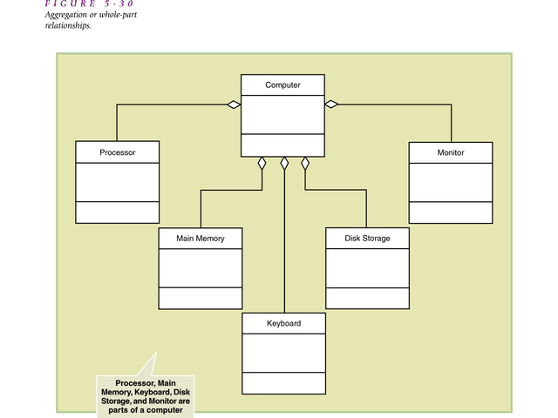

Slide 14
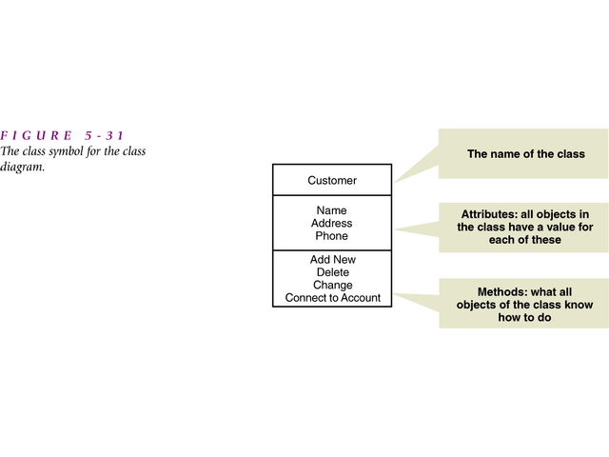
Example of Class Diagram Notation

Slide 15
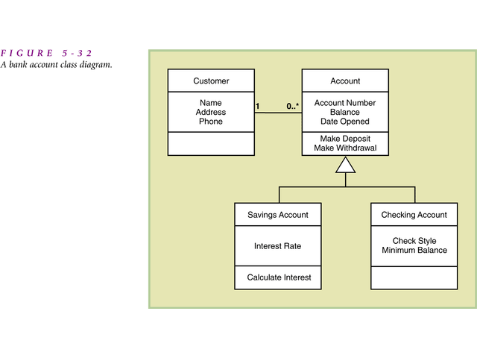
Another Example of Class Diagram Notation

Slide 16
Learning Objectives
Understand the models and processes of defining object-oriented requirements
Develop use case diagrams and activity diagrams
Develop system sequence diagrams
Develop state machine diagrams to model object behavior
Explain how UML diagrams work together to define functional requirements for the object-oriented approach
Systems Analysis and Design in a Changing World, 5th Edition

Slide 17
The System Activities—
A Use Case/Scenario View
Use case analysis used to identify and define all business processes that system must support
Use case – an activity a system carried out, usually in response to a user request
Actor
  Role played by user
  Outside automation boundary
Systems Analysis and Design in a Changing World, 5th Edition

Slide 18
Techniques for Identifying Use Cases (Review from Chapter 5)‏
Identify user goals
  Each goal at the elementary business process (EBP) level is a use case
  EBP – task performed by one user in one place and in response to business event that adds measurable business value, and leaves system and data in consistent state
Event decomposition technique (event table)‏
CRUD analysis technique (create, read/report, update, delete) to ensure coverage
Systems Analysis and Design in a Changing World, 5th Edition

Slide 19
Use Case Diagram
Graphical UML diagram that summarizes information about actors and use cases
Simple diagram shows overview of functional requirements
Can have multiple use case diagrams
  By subsystem
  By actor
Systems Analysis and Design in a Changing World, 5th Edition

Slide 20
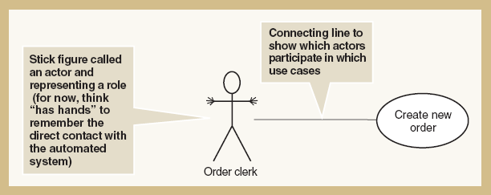
Simple Use Case with an Actor
Figure 7-2
Systems Analysis and Design in a Changing World, 5th Edition

Slide 21
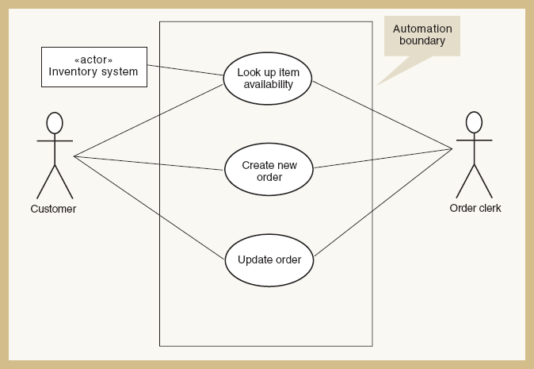
Use Case Diagram with Automation Boundary and Alternate Actor Notation
Figure 7-3
Systems Analysis and Design in a Changing World, 5th Edition

Slide 22
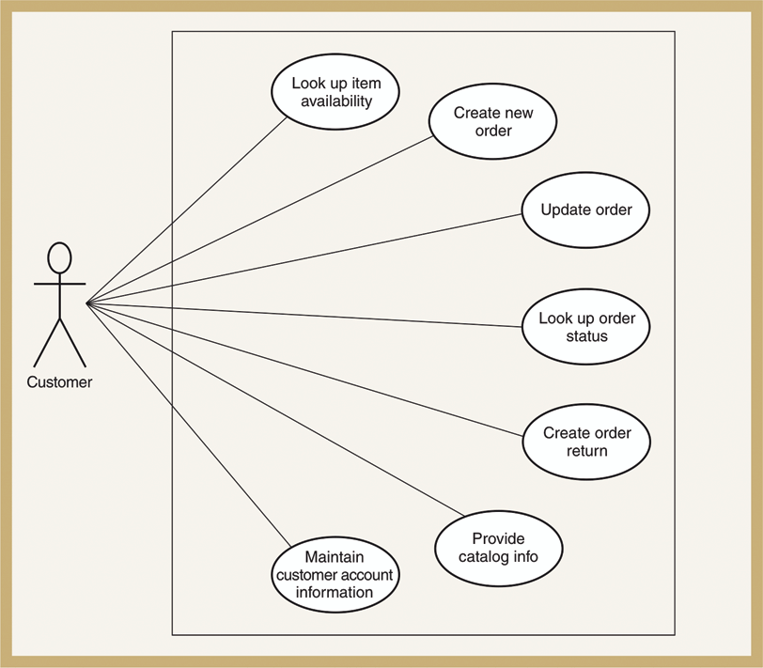
All Use Cases Involving Customer as Actor
Figure 7-4
Systems Analysis and Design in a Changing World, 5th Edition

Slide 23
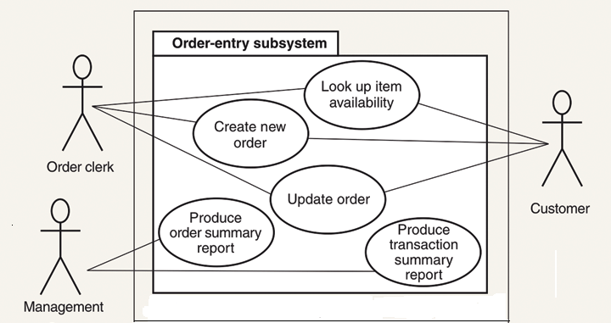
Use Cases of RMO Order Entry Subsystem
Figure 7-5 (partial figure)‏
Systems Analysis and Design in a Changing World, 5th Edition

Slide 24
<<Includes>> Relationship
Documents situation in which one use case requires the services of a common subroutine
Another use case is developed for this common subroutine
A common use case can be reused by multiple use cases
Systems Analysis and Design in a Changing World, 5th Edition

Slide 25
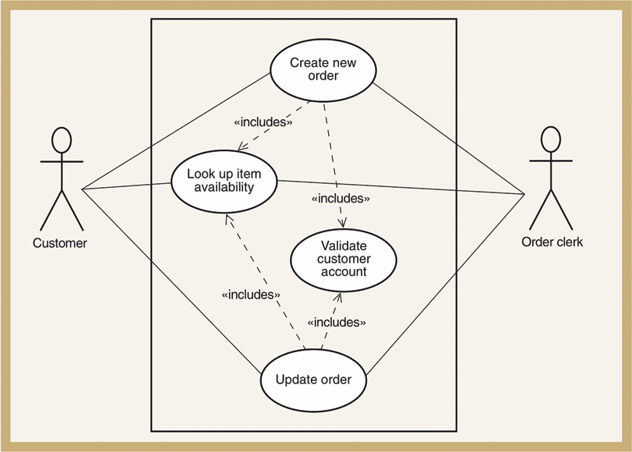
Example of Order-Entry Subsystem with <<Includes>> Use Cases
Figure 7-6
Systems Analysis and Design in a Changing World, 5th Edition

Slide 26
Developing a Use Case Diagram
Underlying conditions for describing use cases
  Based on automated system, e.g. users “touch” the system
  Assume perfect technology condition
Iterate through these two steps
  Identify actors as roles
  List goals, e.g. use cases, for each actor. A goal is a unit of work.
Finalize with a CRUD analysis to ensure completeness
Systems Analysis and Design in a Changing World, 5th Edition

Slide 27
Activity Diagrams
Used to document workflow of business process activities for each use case or scenario
Standard UML 2.0 diagram as seen in Chapter 4
Can support any level of use case description; a supplement to use case descriptions
Helpful in developing system sequence diagrams
Systems Analysis and Design in a Changing World, 5th Edition

Slide 28
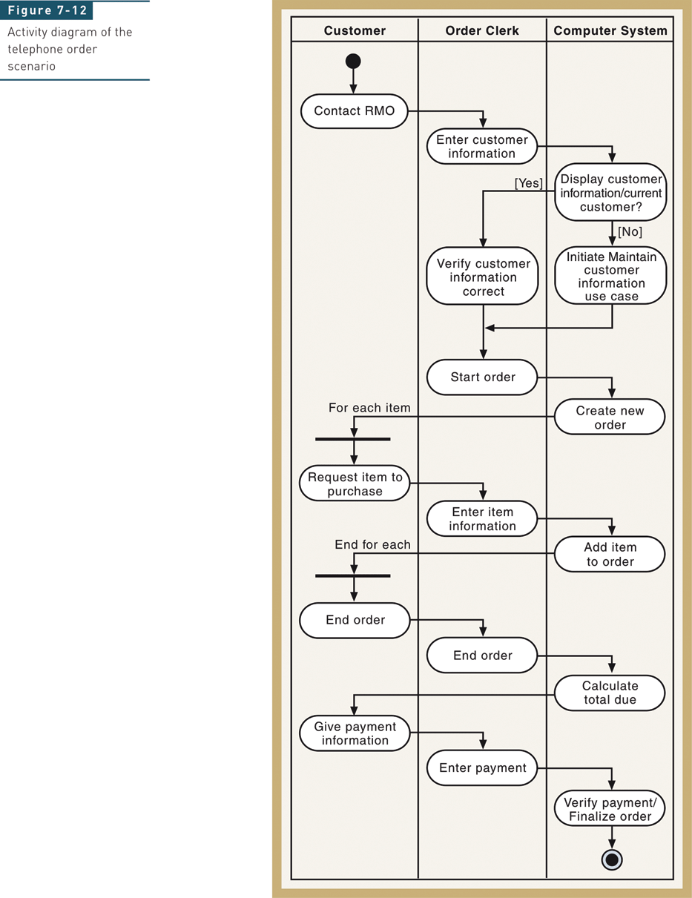
Activity Diagram— Telephone Order Scenario
Figure 7-8
Systems Analysis and Design in a Changing World, 5th Edition

Slide 29
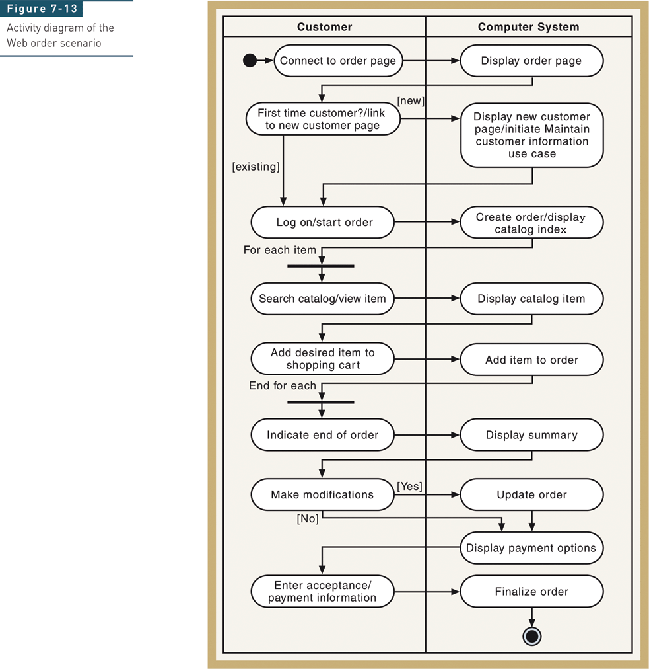
Activity Diagram—
Web Order Scenario
Figure 7-9
Systems Analysis and Design in a Changing World, 5th Edition

Slide 30
Identifying Inputs and Outputs—
The System Sequence Diagram
Interaction diagram – a communication diagram or a sequence diagram
System sequence diagram (SSD) is type of UML 2.0 interaction diagram
Used to model input and output messaging requirements for a use case or scenario
Shows sequence of interactions as messages during flow of activities
System is shown as one object: a “black box”
Systems Analysis and Design in a Changing World, 5th Edition

Slide 31
SSD Notation
Lifeline or object lifeline is a vertical line under object or actor to show passage of time for object
Message is labeled on arrows to show messages sent to or received by actor or system
Actor is role interacting with the system with messages
Object is the component that interacts with actors and other objects
Systems Analysis and Design in a Changing World, 5th Edition

Slide 32
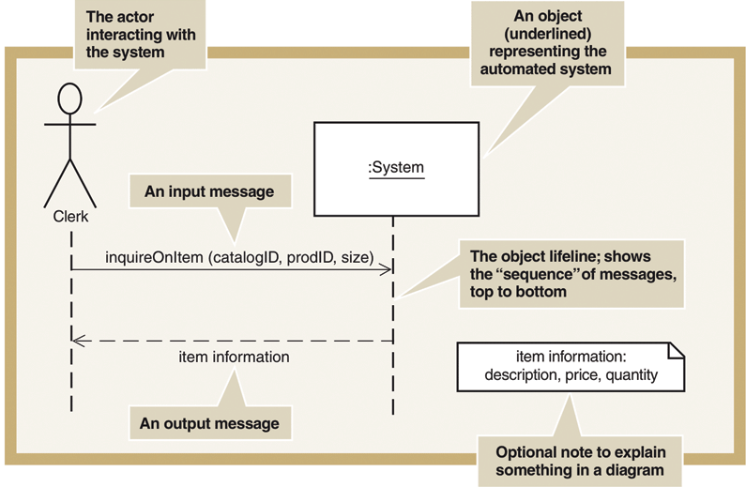
System Sequence Diagram (SSD) Notation
Figure 7-10
Systems Analysis and Design in a Changing World, 5th Edition

Slide 33
SSD Lifelines
Vertical line under object or actor
  Shows passage of time
If vertical line dashed
  Creation and destruction of thing is not important for scenario
Long narrow rectangles
  Activation lifelines emphasize that object is active only during part of scenario
Systems Analysis and Design in a Changing World, 5th Edition

Slide 34
SSD Messages
Internal events identified by the flow of objects in a scenario
Requests from one actor or object to another to do some action
Invoke a particular method
Systems Analysis and Design in a Changing World, 5th Edition

Slide 35
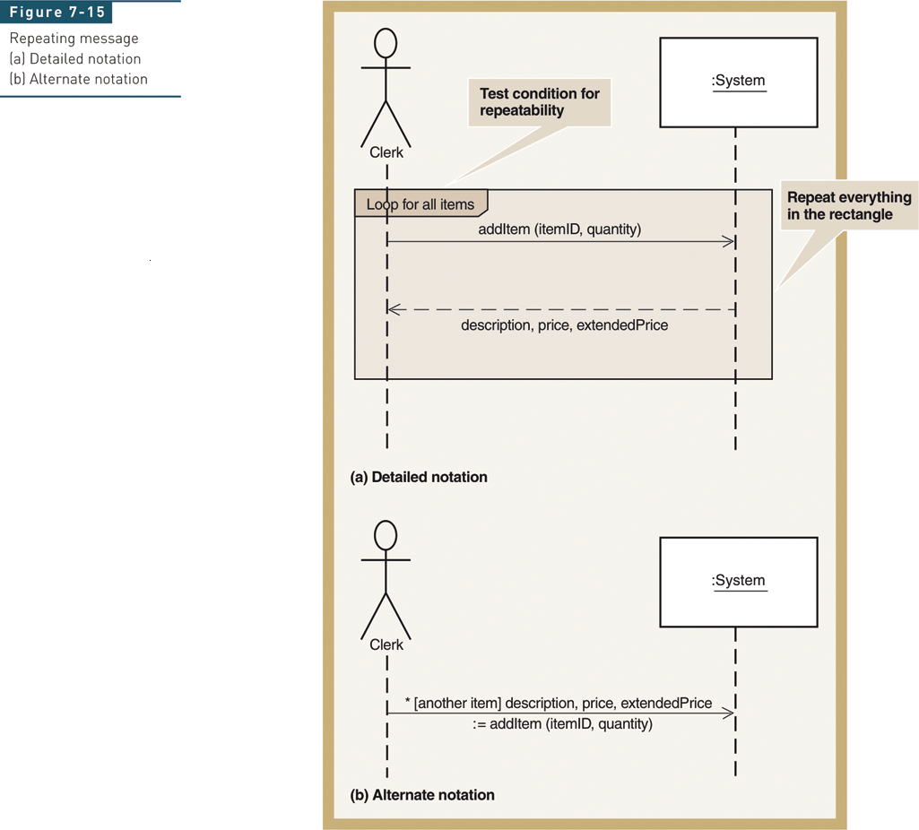
Repeating Message
Figure 7-11
Systems Analysis and Design in a Changing World, 5th Edition

Slide 36
Developing a System Sequence Diagram
Begin with detailed description of use case from fully developed form or activity diagram
Identify input messages
Describe message from external actor to system using message notation
Identify and add any special conditions on input message, including iteration and true/false conditions
Identify and add output return messages
Systems Analysis and Design in a Changing World, 5th Edition

Slide 37
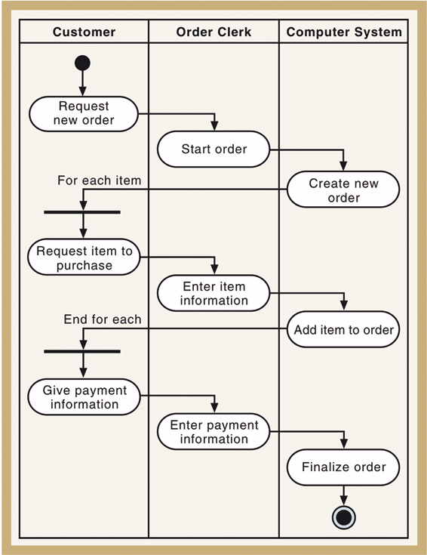
Activity Diagram of the Telephone Order Scenario
Figure 7-12
Systems Analysis and Design in a Changing World, 5th Edition

Slide 38
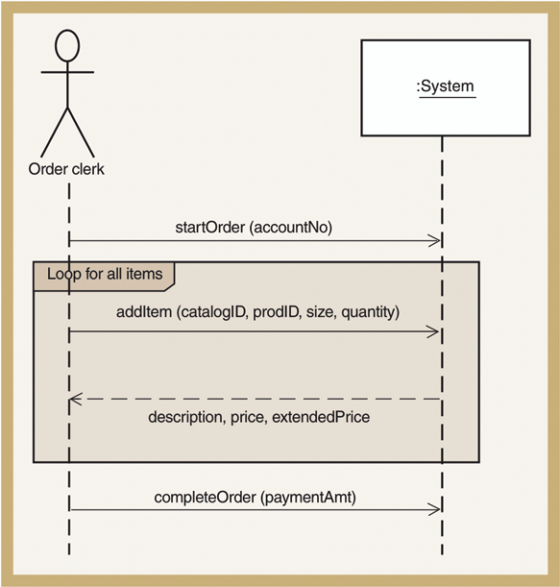
Resulting SSD for the Telephone Order Scenario
Figure 7-13
Systems Analysis and Design in a Changing World, 5th Edition

Slide 39
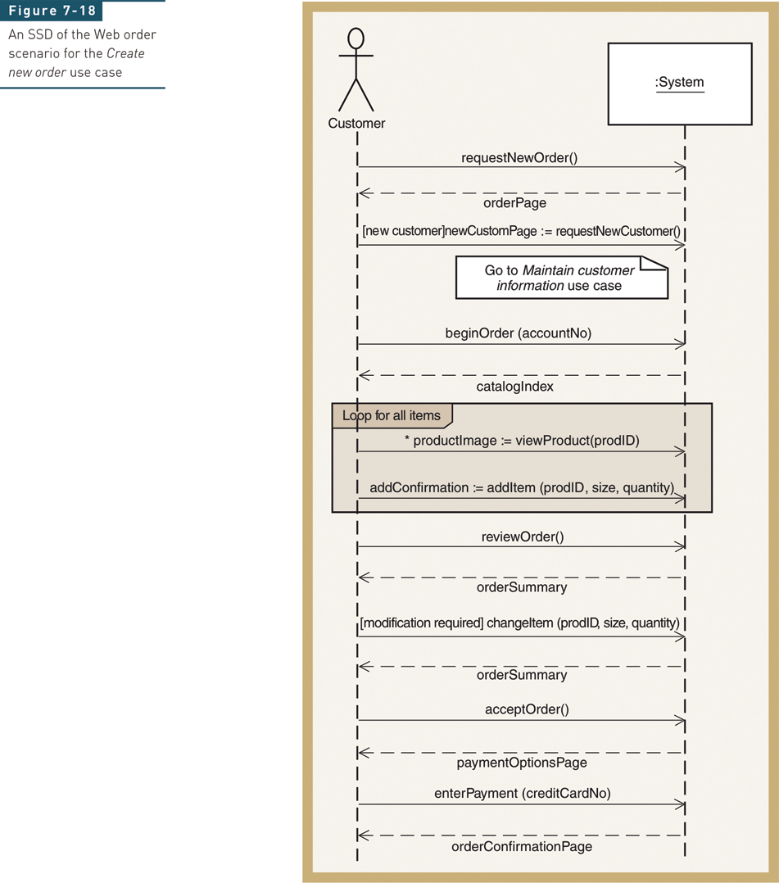
SSD of the Web Order Scenario for the Create New Order Use case
Figure 7-14
Systems Analysis and Design in a Changing World, 5th Edition

Slide 40
Identifying Object Behavior—
The State Machine Diagram
State machine diagram is UML 2.0 diagram that models object states and transitions
  Complex problem domain classes can be modeled
State of an object
  A condition that occurs during its life when it satisfies some criterion, performs some action, or waits for an event
  Each state has unique name and is a semipermanent condition or status
Transition
  The movement of an object from one state to another state
Systems Analysis and Design in a Changing World, 5th Edition

Slide 41
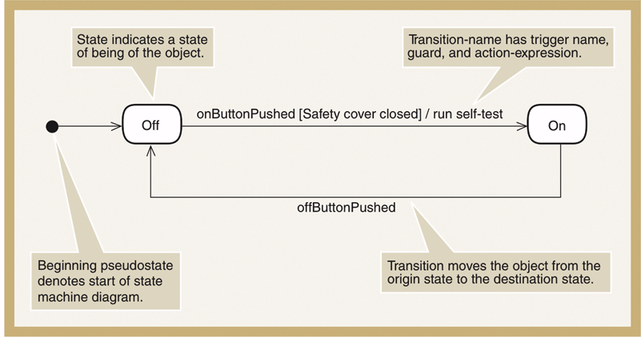
Simple State Machine Diagram for a Printer
Figure 7-15
Systems Analysis and Design in a Changing World, 5th Edition

Slide 42
State Machine Terminology
Pseudostate – the starting point of a state machine, indicated by a black dot
Origin state – the original state of an object from which the transition occurs
Destination state – the state to which an object moves after the completion of a transition
Message event – the trigger for a transition, which causes the object to leave the origin state
Guard condition – a true/false test to see whether a transition can fire
Action expression – a description of the activities performed as part of a transition
Systems Analysis and Design in a Changing World, 5th Edition

Slide 43
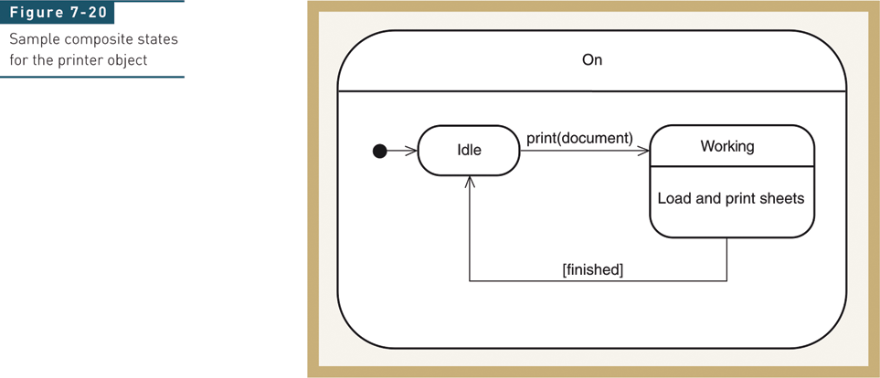
Composite States and Concurrency—States within a State
Figure 7-16
Systems Analysis and Design in a Changing World, 5th Edition

Slide 44
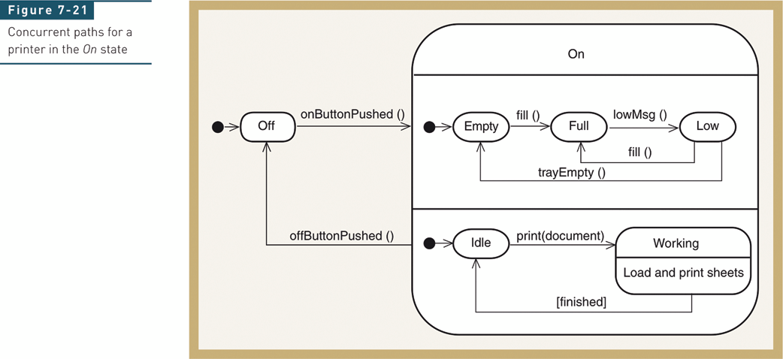
Concurrent Paths for Printer in the On State
Figure 7-17
Systems Analysis and Design in a Changing World, 5th Edition

Slide 45
Rules for Developing State Machine Diagram
Review domain class diagram, select important ones, and list all state and exit conditions
Begin building state machine diagram fragments for each class
Sequence fragments in correct order and review for independent and concurrent paths
Expand each transition with message event, guard-condition, and action-expression
Review and test each state machine diagram
Systems Analysis and Design in a Changing World, 5th Edition

Slide 46
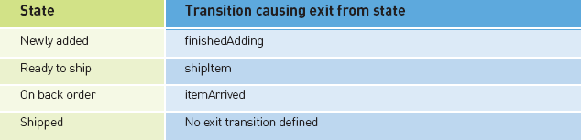
States and Exit Transitions for OrderItem
Figure 7-18
Systems Analysis and Design in a Changing World, 5th Edition

Slide 47
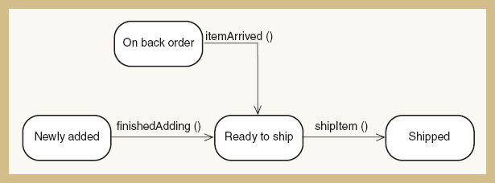
Partial State Machine for OrderItem
Figure 7-19
Systems Analysis and Design in a Changing World, 5th Edition

Slide 48
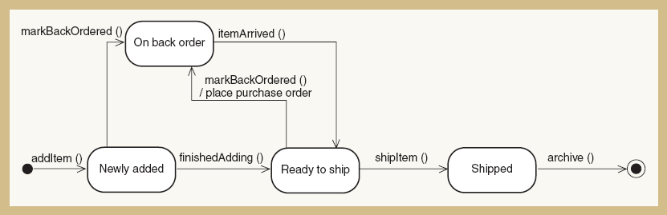
Final State Machine for OrderItem
Figure 7-20
Systems Analysis and Design in a Changing World, 5th Edition

Slide 49
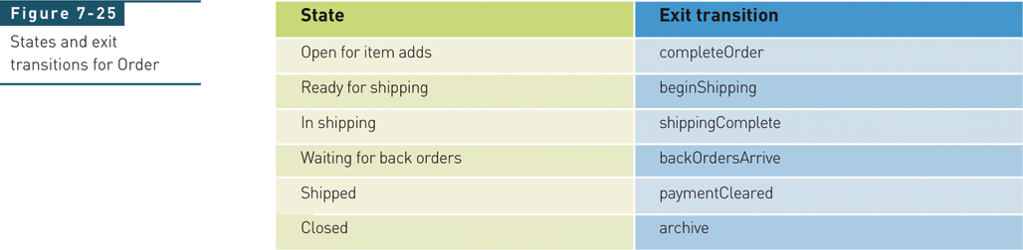
Order Domain Class for RMO—
States and Exit Transitions
Figure 7-21
Systems Analysis and Design in a Changing World, 5th Edition

Slide 50
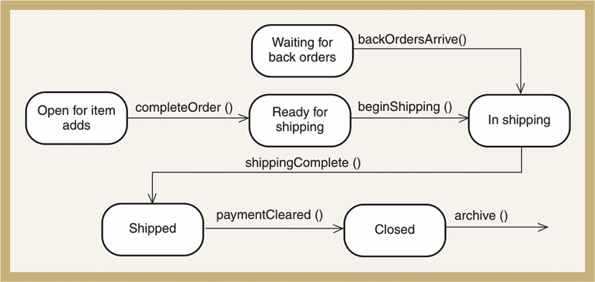
First-Cut State Machine Diagram for Order
Figure 7-22
Systems Analysis and Design in a Changing World, 5th Edition

Slide 51
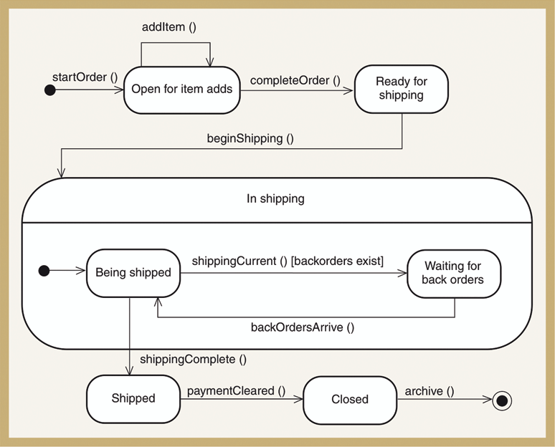
Second-Cut State Machine Diagram for Order
Figure 7-23
Systems Analysis and Design in a Changing World, 5th Edition

Slide 52
Integrating Object-Oriented Models
Complete use case diagram is needed to understand total scope of new system
Domain model class diagrams should also be as complete as possible for entire system
With iterative approach, only construct use case descriptions, activity diagrams, and system sequence diagrams for use cases in iteration
Development of a new diagram often helps refine and correct previous diagrams
Systems Analysis and Design in a Changing World, 5th Edition

Slide 53
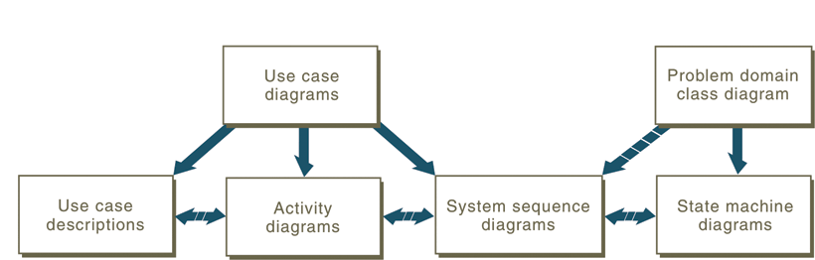
Relationships Between OO
Requirements Models
Figure 7-24
Systems Analysis and Design in a Changing World, 5th Edition

